Slide 1

Urban Sound Classification
Ronald Pacheco

Slide 2
What is the problem?
We are looking to create a deep learning supervised multiclass classification model to successfully classify common sounds of an urban environment for home security systems.

Slide 3
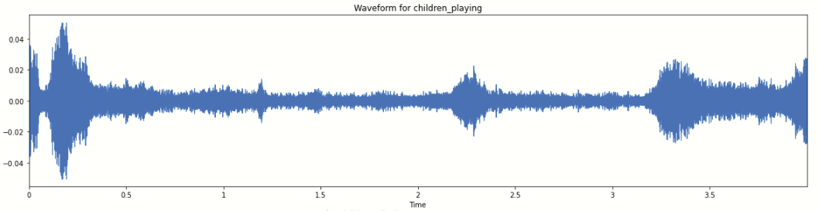
The data consists of 5,435 audio files distributed amongst 10 classes
Data Source: https://datahack.analyticsvidhya.com/contest/practice-problem-urban-sound-classification/#ProblemStatement

Slide 4
Feature Extraction
zcr: measures how many times the signal crosses 0
tonnetz: Computes the tonal centroid features
melspectrogram: Compute a Mel-scaled power spectrogram
mfcc: Mel-frequency cepstral coefficients
chorma_stft: Compute a chromagram from a waveform or power spectrogram
spectral_contrast: Compute spectral contrast
spectral_centroid: Indicates at which frequency the energy of a spectrum is centered upon
spectral_rolloff: Represents the frequency at which high frequencies decline to 0
spectral_bandwidth: The width of the band of light at one-half the peak maximum
From each audio file, the nine following features were extracted, resulting in a dataframe of 5,435 rows and 186 columns.

Slide 5
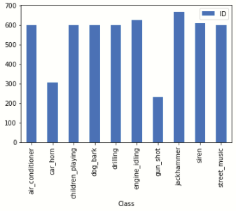
Class Distribution
Most classes had ~600 observations, with the exception of ‘car_horn’ and ‘gun_shot’

Slide 6
Modeling
model = Sequential()
model.add(Dense(182, input_shape=(X_train.shape[1],), activation = 'relu'))
model.add(Dense(256, activation = 'relu'))
model.add(Dropout(0.6))
model.add(Dense(128, activation = 'relu'))
model.add(Dropout(0.5))
model.add(Dense(len(y.columns), activation = 'softmax'))
model.compile(loss='categorical_crossentropy', metrics=['accuracy'], optimizer='adam')
A neural network was trained with the class imbalance, having an initial accuracy of 91.83%

Slide 7
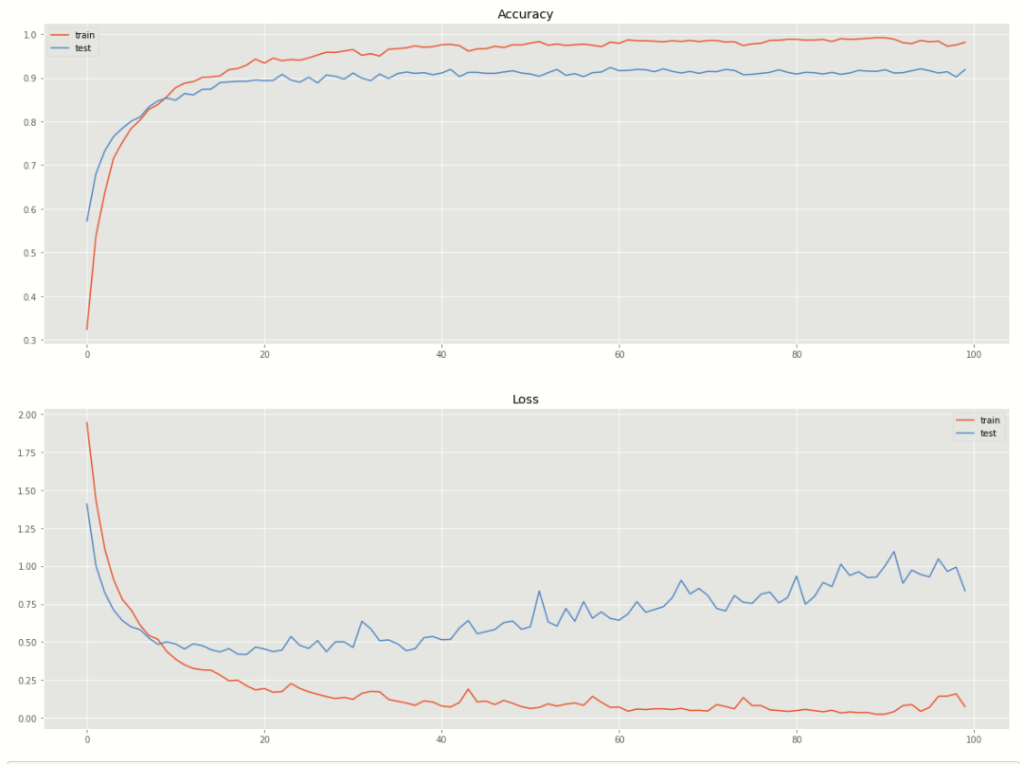
Accuracy & Loss curves per Epoch for Train and Test sets.

Slide 8
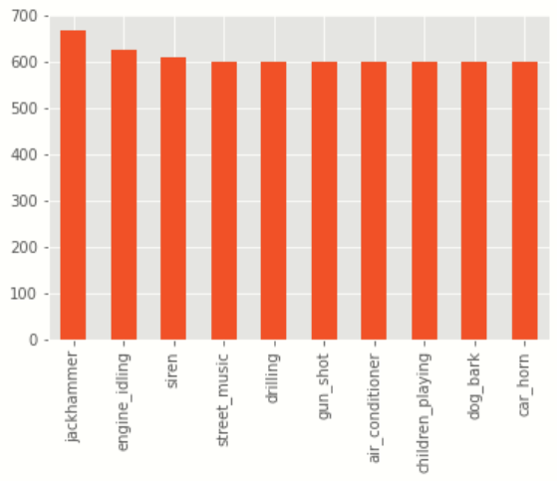
Balancing the data
We used bootsrapping to upsample ‘car_horn’ and ‘gun_shot’ to 600 observations

Slide 9
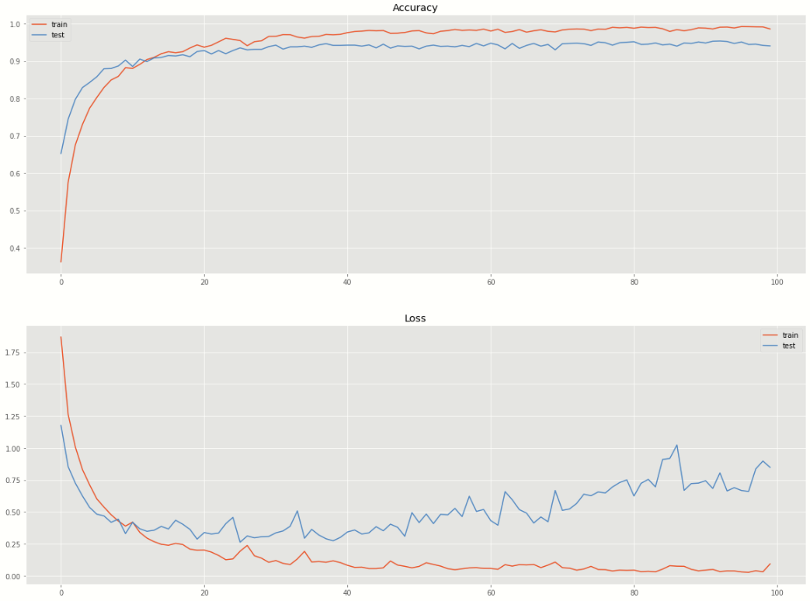
New model with balanced data
We ran the balanced data using the same neural network and got an improved accuracy of 94.03%. An improvement of 2.2%.

Slide 10
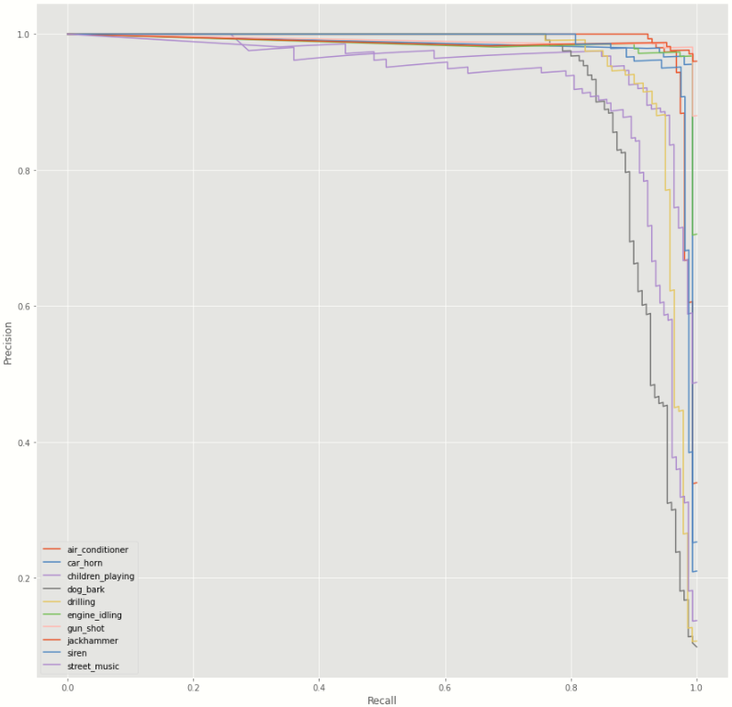
Precision/Recall curves

Slide 11
Future Work
Filters can be applied to the sound files to try and reduce the amount of noise. This would give us a clearer audio that might be easier to correctly classify, improving the model’s accuracy.

Slide 12
Recommendations
These classes can be grouped into different categories, which will represent the type of action required.
Based on the predicted class, a decision can be made regarding the type of activity happening in said residence. This can take into account other factors, such as time of day, crime rate in the area, type of crimes, etc.

Slide 13
Conclusions
This project serves as proof of concept for the business case. More audio files (such as glass breaking, door breaking, etc.) need to be gather in order to have a successful model than can be useful in this application.

Slide 14
Thank you!

